Slide 1
Lecture 9 - Service Integration, Orchestration, Security and Governance

Slide 2
Integration
Plumbing different software applications/services/systems and forming new software solutions is known as ‘Enterprise Integration’.

Slide 3
When SOA Integration is Used?
● Build new applications
● Expose a business function
● Reuse services to build new processes ● Business process automation ● Integrate data for analytics

Slide 4
Importance of Integration in SOA
● Enterprises heavily rely on the underlying software systems/services/applications.
● Disparate technologies and platforms ● No single solution or a vendor ● Diverse Business requirements

Slide 5
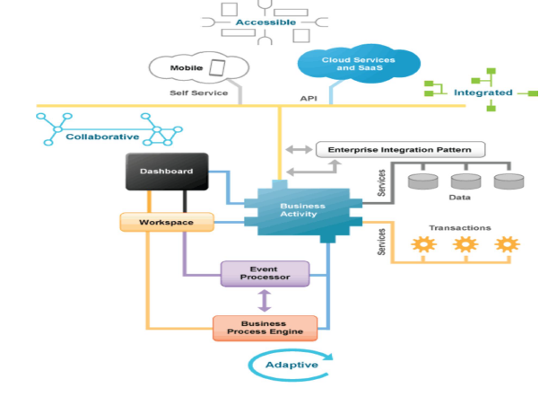
An Example

Slide 6
Challenges of Integration
● Heterogeneity: Disparate systems, protocols and standards
● Variety: Legacy systems, SOAP/REST services, Cloud APIs
● Disorganized: Spaghetti architecture, poorly managed ● Costly: Hardly scalable and maintainable ● Unquantifiable: Difficult to measure throughput & productivity

Slide 7
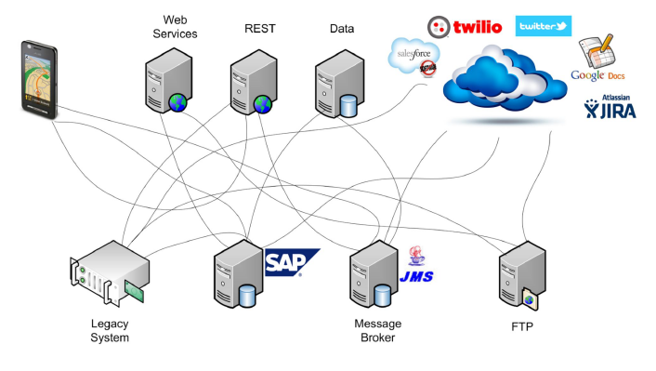
Unplanned Integration

Slide 8
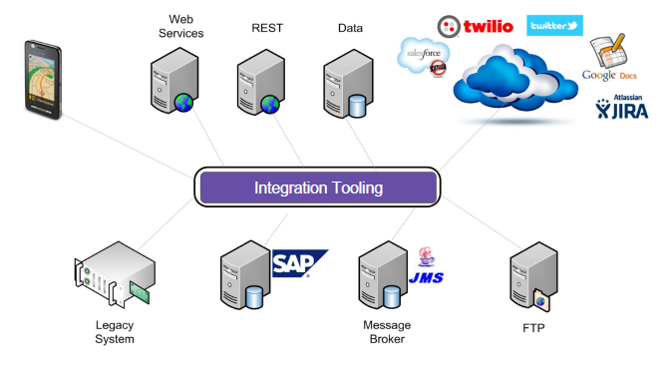
Integration Tooling
Integration Tooling

Slide 9
ESB
Implements a communication system between mutually interacting
Software applications/services in a service-oriented architecture
● Routes
● Transforms ● Mediation

Slide 10
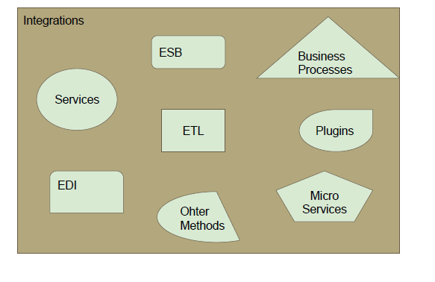
Integration Tooling - SOA and Non-SOA

Slide 11
ESB - Meets SOA Integration Challenges
● Transports: Support for web (HTTP), files (VFS),
e-mail (POP, IMAP) and more..
● Formats/ Protocols: XML, JSON, CSV, EDI, SOAP,
REST and more..
● Domain specific apps: Financial Services (FIX),
Healthcare (HL7)..
● COTS: SAP, IBM WebSphere MQ, MSMQ and more..
● Cloud apps: Salesforce, Google Apps, Twitter, JIRA and more..
● Custom extensions: Handles proprietary/ non-standard
integration cases

Slide 12
Hands On
Using an ESB for Integration

Slide 13
Enterprise Integration Patterns
● A design Pattern - A pattern that keeps occurring
● Solution architects over the years found some patterns that kept recurring
http://www.enterpriseintegrationpatterns.com/books1.html
● Gregor Hope published a book - Enterprise Integration Patterns : Designing, Building, and Deploying Messaging Solutions
Contains 65 integration patterns

Slide 14
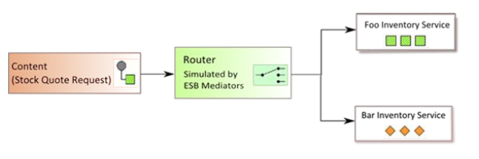
Enterprise Integration Patterns
Content Based Routing

Slide 15
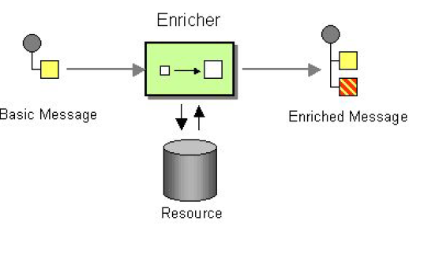
Enterprise Integration Patterns
Enricher

Slide 16
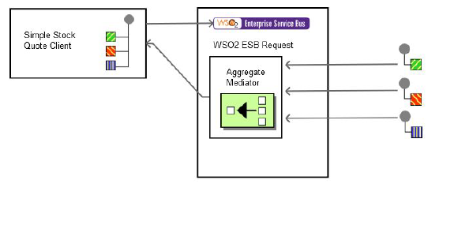
Enterprise Integration Patterns
Aggregator

Slide 17
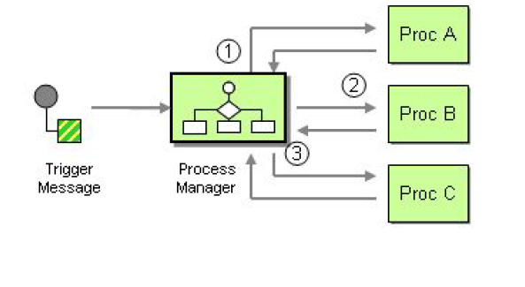
Enterprise Integration Patterns
Process Manager

Slide 18
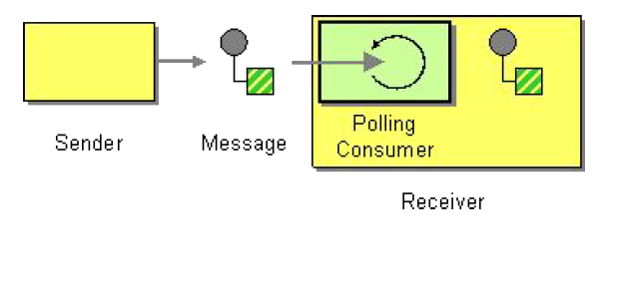
Enterprise Integration Patterns
Polling Consumer

Slide 19
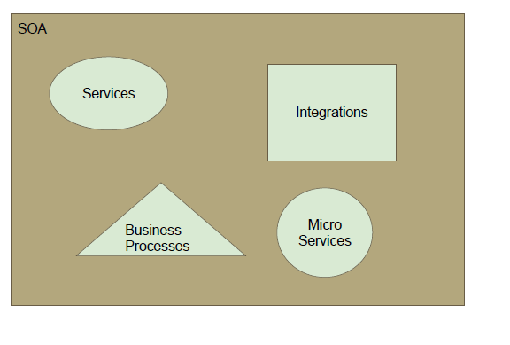
SOA Space

Slide 20
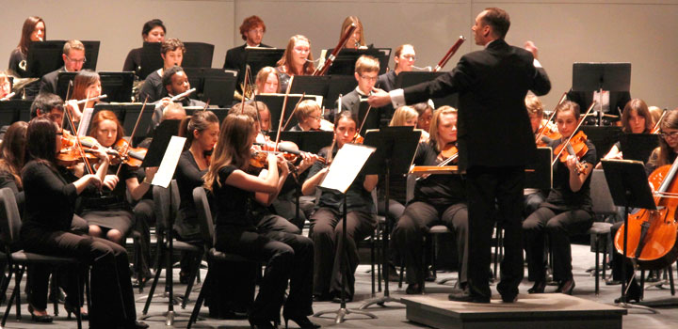
Service Orchestration

Slide 21
Service Orchestration
Process Logic module is like a leader in an orchestration
Services need to be linked and sequenced to form an application
This process is known as orchestration.
Orchestration Models
Activity diagram
State charts
Petri Nets
Activity Hierarchy
Etc.

Slide 22
Orchestration vs. Choreography
Orchestration
An executable business process describing a flow from the perspective and under control of a single endpoint
Choreography
The observable public exchange of messages, rules of interaction and agreements between two or more business process endpoints
web service
web service
collaboration
web service
web service
web service
process flow
web service

Slide 23

Service Choreography
*

Slide 24
Choreography
Does not rely on a central coordinator
Each Web service involved in the choreography knows exactly when to execute its operations and with whom to interact
Collaborative effort focusing on the exchange of messages in public business processes
All participants in the choreography need to be aware of the business process, operations to execute, messages to exchange, and the timing of message exchanges.

Slide 25
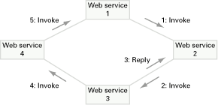
Choreography
5. Invoke
1. Invoke
3. Reply
4. Invoke
2. Invoke

Slide 26
Orchestration versus Choreography
From the perspective of composing Web services to execute business processes, orchestration is a more flexible paradigm and has the following advantages over choreography:
The coordination of component processes is centrally managed by a known coordinator.
Web services can be incorporated without their being aware that they are taking part in a larger business process.
Alternative scenarios can be put in place in case faults occur.

Slide 27
Orchestration versus Choreography
BPEL supports two different ways of describing business processes that support orchestration and choreography:
Executable processes allow you to specify the exact details of business processes. They follow the orchestration paradigm and can be executed by an orchestration engine.
Abstract business protocols allow specification of the public message exchange between parties only. They do not include the internal details of process flows and are not executable. They follow the choreography paradigm.

Slide 28
Business Processes & BPEL
A business process is a collection of interrelated tasks, which are designed to deliver a particular result
A business process can be decomposed into several sub-processes, which have their own attributes, but are aligned with the goal of the overall process
The analysis of business processes typically includes the mapping of processes and sub-processes down to an activity level
BPEL: Business Process Execution Language

Slide 29
BPEL
Basically a tool to create programs using flow diagrams, whose building blocks are individual services
Really meant for business analysts, not programmers
Facilitates orchestration without knowing how to code
Programmers would do it in a ‘proper’ programming language
WSBPEL is a BPEL implementation for Web Services
BPEL could apply to other SOA approaches

Slide 30
BPEL
BPEL is an XML-based language.
It is an open standard – not proprietary
BPEL scope includes:
Sequencing of process activities, especially Web Service interactions
Correlation of messages and process instances
Recovery behavior in case of failures and exceptional conditions
Bilateral Web Service based relationships between process roles

Slide 31
BPEL Activity
A BPEL process consists of steps. Each step is called an activity.
BPEL supports primitive and structural activities.
Primitive activities represent basic constructs and are used for common tasks, such as those listed below:
Invoking Web services, using <invoke>
Waiting for the request, using <receive>
Manipulating data variables, using <assign>
Indicating faults and exceptions, using <throw>, etc.

Slide 32
BPEL Activity
We can then combine these activities into more complex algorithms that specify the steps of a business process.
To combine primitive activities, BPEL supports several structure activities.
The most important are:
Sequence (<sequence>) for defining a set of activities that will be invoked in an ordered sequence
Flow (<flow>) for defining a set of activities that will be invoked in parallel
Case-switch construct (<switch>) for implementing branches
While (<while>) for defining loops, etc.

Slide 33
BPEL-Example
<receive> and <reply> activities receive messages from and give feedback to customers
<invoke> activities are used to trigger internal and/or external web services
<parallel flow> activity allows tasks to be executed concurrently.
<switch> activity allows conditional behaviours in business process.
<receive>
Receive
Itinerary
<invoke>
Airline
(Web service)
Reserve
Flights
<parallel flow>
<invoke>
Reserve Hotels
Hotel
(Web service)
Notify Customer
Itinerary confirmed
outcome
<switch>
<reply>
Itinerary rejected

Slide 34
A BPEL Process

Slide 35
Structured Activities

Slide 36
Primitive Activities

Slide 37
Data Flow

Slide 38
Partner Links

Slide 39
BPMN (Business Process Markup and Notation)
The primary goal of BPMN is to provide a notation that is readily understandable by all business users
BPMN creates a standardized bridge for the gap between the business process design and process implementation.
Another goal, but no less important, is to ensure that XML languages designed for the execution of business processes, such as BPEL4WS (Business Process Execution Language for Web Services), can be visualized with a business-oriented notation.

Slide 40
The BPEL Process in BPMN

Slide 41
BPMN explained

Slide 42
BPMN Vs BPEL
BPMN is richer than BPEL
Transformation from BPEL to BPMN less a problem
From BPMN to BPEL
Loss of information
Loss of design considerations
Potential Solutions
Restriction to a subset of BPMN
Extension of BPEL

Slide 43
The Top Down Perspective
Notation Layer BPMN or UML
Business Analyst
Activity
Activity
Activity
Executable Layer XML, XQuery, BPEL, Rules
Integration Developer
assign
invoke
receive
assign
Business Services Adapters, Java, Struts, JSF
Service Developer
Existing Systems
DATABASE
PACKAGED
APPLICATIONS
JAVA
MAINFRAME

Slide 44
Securing Web Services

Slide 45
Security Fundamentals
● Authentication
● Authorization ● Integrity
● Confidentiality ● Availability
● Non-Repudiation

Slide 46
Authentication
● Digital Identity of the user is valid and verified ○ Something you know
○ Something you have ○ Something you are

Slide 47
Authorization
● Ensures that the identified person is authorized to see/edit the contents

Slide 48
Availability
● Application is up and running ● Service is up and running
● Authorized authenticated users can obtain services and information

Slide 49
Confidentiality
● Information and services are available.
● Unauthorized parties cannot access information

Slide 50
Integrity
● Ensures the service provides users with correct information
● No obsolete or outdated information is presented

Slide 51
Non-repudiation
● The sender should not be able deny sending the message
● The receiver should not be able to deny their involvement

Slide 52
Why Secure Web Service
● Authenticated
● Authorized
● Confidentiality ● Integrity
● Availability
● Non-repudiation

Slide 53
Security a Web Service
● WS-Security
● SSL with HTTP BasicAuth/HTTP Digest Auth ● SSL with Username Token

Slide 54
WS Security
● WS Security 1.0 on 2004 and 1.1 on 2006 ● Based on
○ PKI
○ X509 Certificates
○ XML Security - XML Encryption and Signature ● Related Standards
○ WS Secure Conversation ○ WS Trust

Slide 55
WS Security
● Username Token
● Message level encryption ● Message level signature
● Message level encryption and signature

Slide 56
WS Security Sepcification Family
● A comprehensive specification ● Provides message level security ● Industry is no longer using it

Slide 57
TLS for HTTP → HTTPS
● TLS - Transport Layer Security ○ Version 1, 1.1, 1.2 and 1.3 ● Predecessor of TLS is SSL
● Adds an additional encryption layer over HTTP ● Transport layer provides
○ Transport level confidentiality ○ Transport level integrity

Slide 58
HTTP BasicAuth
● HTTP Header with Username & Password ○ Authorization : Basic <Base64 encoded
Username:Password>
● Base64 is not encryption. What is it? ○ Difference between
■ Encoding
■ Encryption
■ Hashing

Slide 59
Hands-on
Create a BasicAuth Header

Slide 60
Demo
HTTP Basic Auth Sample

Slide 61
TLS with BasicAuth
● Provides Authenticity
● Possible to do Authorization
● Transport layer confidentiality and integrity

Slide 62
More on Hashing
● Irreversible. Result is called digest. ○ d = hash(m1)
● Deterministic
● Small change → Drastic result in the digest
● Second image resistance. Given d=hash(m1), it is hard to find m2 such that d=hash(m2)
● Collision resistance
○ hash(m1) = hash(m2)

Slide 63
Cryptographic Nonce
● A number tht is used only once ● Random Number
● Adding a Nonce to a message before hashing makes the Digest attacks hard

Slide 64
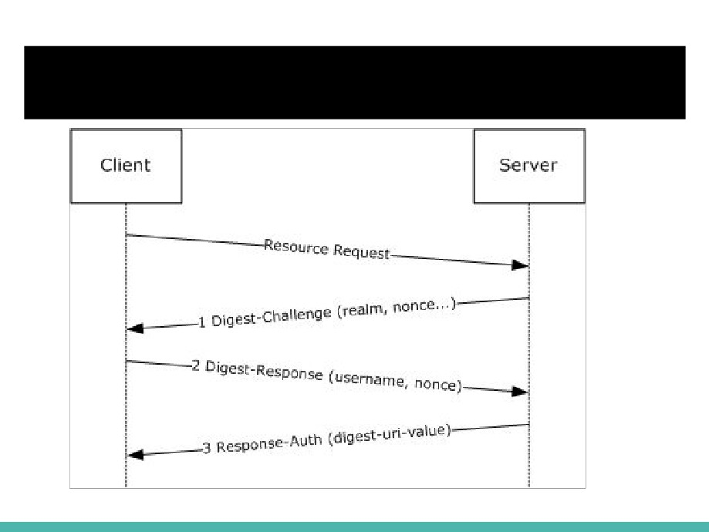
HTTP DigestAuth

Slide 65
Http DigestAuth
STEP 1 : a client sends a request to a server
STEP 2 : the server responds with a special code (called a nonce i.e. number used only once), another string representing the ‘realm’ and asks the client to authenticate
STEP 3 : the client responds with this nonce and an encrypted version of the username, password and realm (a hash)
STEP 4 : the server responds with the requested information if the client hash matches their own hash of the username, password and realm, or an error if not

Slide 66
TLS with HTTP DigestAuth
● Secure than BasicAuth
● Provides Authenticity
● Possible to do Authorization
● Transport layer confidentiality and integrity

Slide 67
SSL with Username Token
<S11:Envelope xmlns:S11="..." xmlns:wsse="..." xmlns:wsu= "..."> <S11:Header>
<wsse:Security>
<wsse:UsernameToken>
<wsse:Username>James</wsse:Username> <wsse:Password
Type="...#PasswordDigest">weYI3nXd8LjMNVksCKFV8t3rgHh3Rw==</wsse:Password> <wsse:Nonce>WScqanjCEAC4mQoBE07sAQ==</wsse:Nonce>
<wsu:Created>2003-07-16T01:24:32</wsu:Created> </wsse:UsernameToken>
</wsse:Security>
</S11:Header> </S11:Envelope>

Slide 68
Technologies
● SSL for transport security ● API Key
● HTTP BasicAuth/DigestAuth ● OAuth 2.0

Slide 69
OAuth for Security REST Services
● OAuth1.0 & 2.0
○ Open standard for Authorization
● OAuth 2.0 Framework and Bearer Token Usage RFC published on 2012
● OAuth2.0 - Most commonly used standard for security REST Services
○ Facebook Graph API, Google APIs
● Different implementations: e.g. WSO2 Identity Server,

Slide 70
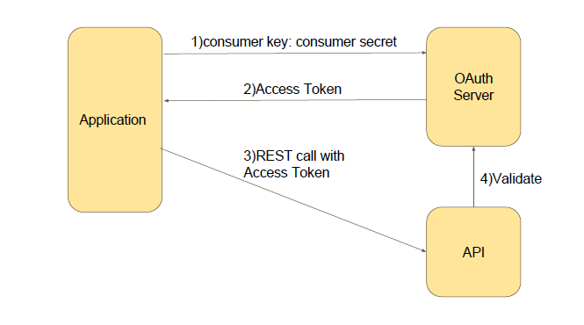
OAuth2.0 Simplified - Client Credential

Slide 71
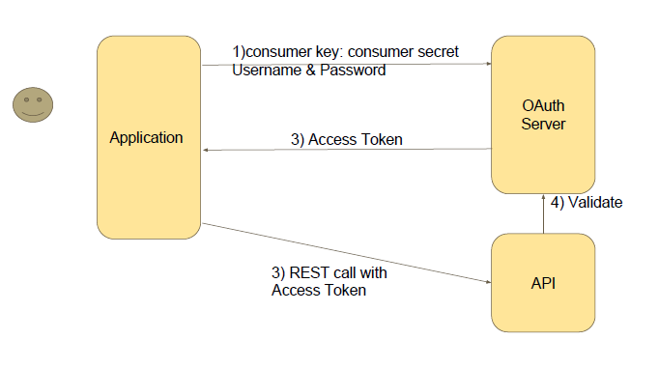
OAuth2.0 Simplified - Username/Password
Grant Type

Slide 72
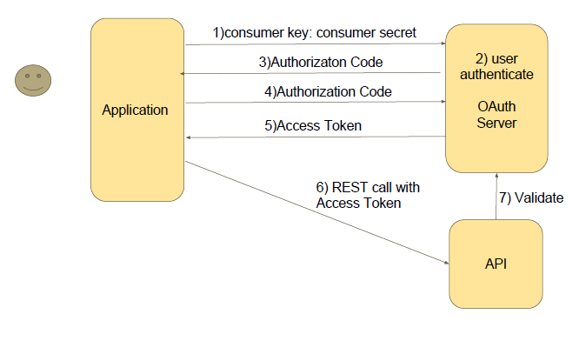
OAuth2.0 Simplified - Authorization code
Grant Type

Slide 73

SOA Governance

Slide 74
SOA Governance
● The “course of action” taken to ensure that an effective decision- making process is in place
● A set of processes, responsibilities and tools, which reinforces
good behavior and help avoid bad behaviors
● Ensure defined processes and responsibilities are followed
through the implementation of proper measurement technique
● It’s all about control!

Slide 75
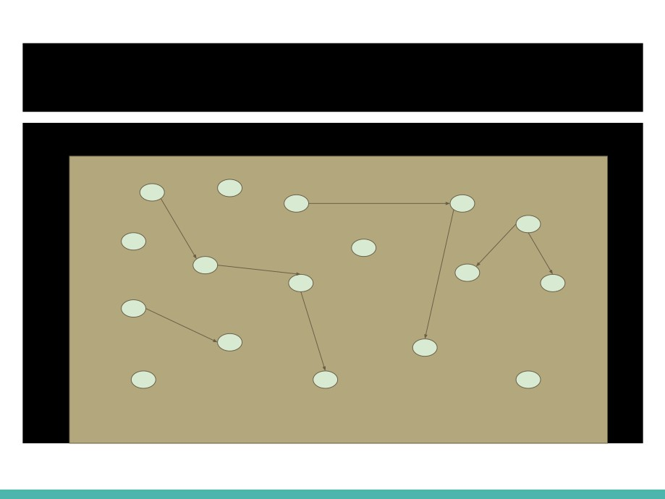
SOA

Slide 76
Why SOA Governance
● Essential part in making SOA successful ○ Need to reuse services
○ Need to make developing application,
automated processes easy ○ Need to manage services

Slide 77
Why SOA Governance
How to promote reuse services
● List services and their descriptions
● Show the technical/business owners of a service ● Analyze inter relationship of service
● Validate the service - Check technical and business rules

Slide 78
Why SOA Governance
Manage Services
● Version the services
● Provide security policies at runtime ● Provide secure access to services ● Track the QoS
● Maintain lifecycle management

Slide 79
When is Governance Required?
● Architecture Governance
● Design-time Governance ● Run-time Governance ● Organizational Governance

Slide 80
How to implement SOA Governance
Service Registry is the central piece of SOA governance ● Service Catalog
● Service Description
● Service Consumption
● Service inter-dependencies ● Service Discovery
● Service Lifecycle ● Service Policies

Slide 81
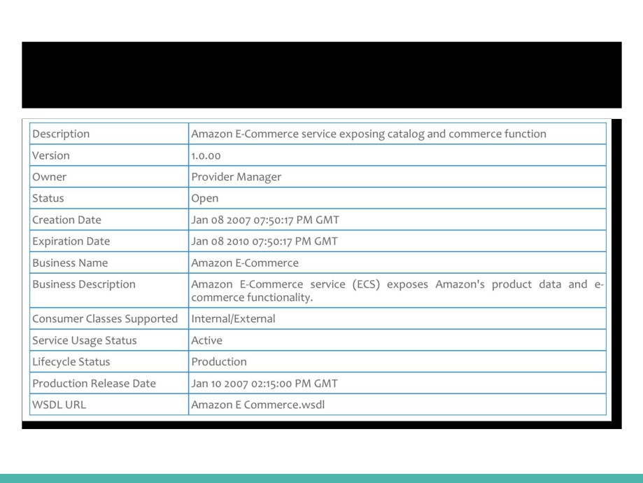
Service Description

Slide 82
UDDI
● A registry standard - Universal Description, Discovery and Integration ● SOAP 1.1 based standard since 2000
○ Describing services
○ Publishing services ○ Discovering services ● Four components ○ Registry
○ Data, meta-data
○ UDDI specification
○ API for publishing, managing and disvoering services

Slide 83
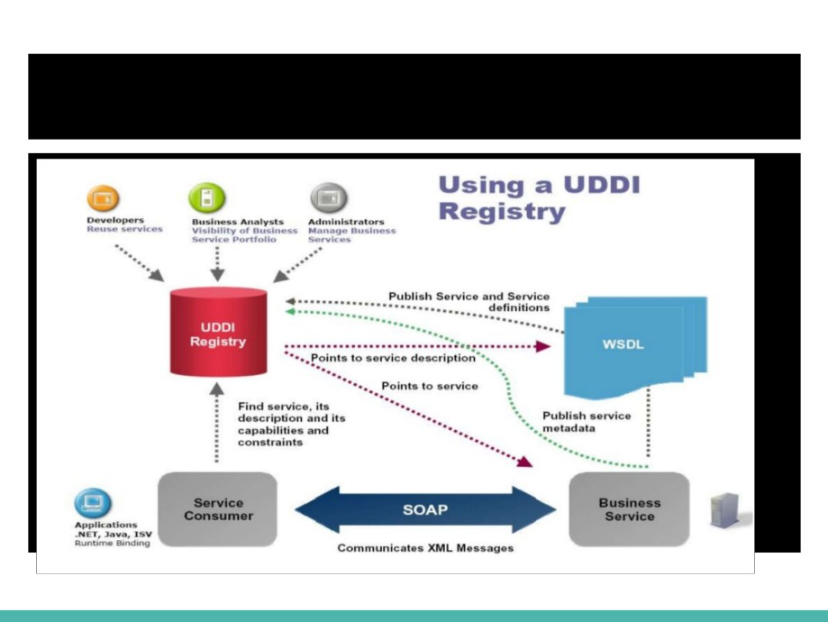
UDDI

Slide 84
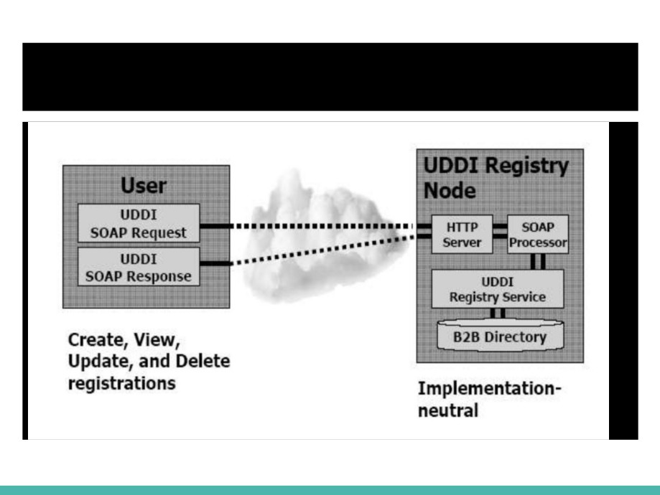
UDDI

Slide 85
Current Registry Implementations
● Infravio
● TIBCO Active Matrix ● BEA
● Oracle ● Sun
● Systinet ● WSO2

Slide 86
UDDI - Low Adoption Rate
● Tightly coupled to SOAP/WSDL
● No homogeneous standard in different business
● Look up services at runtime by clients
- not a common usecase ● Original spec didn’t have human friendly formats
● Hard to use (long document required)
(Governance Interoperability Framework)

Slide 87
Modern Governance Products
● Human friendly service catalog
● Has REST interface - No standard
● Can publish services in different formats ● Integrates with developer tooling ● Innovation enabler, not a restrictor ● Notifications to watchers, workflows ● Lifecycle management

Slide 88
Using a Registry
WSO2 Governance Registry

Slide 89
Summary
Orchestration/Choreography to manage the business process
Service integration to connect services
Enterprise Service Bus
Securing web services
- WS-Security
- HTTP + BasicAuth/HTTP+ DigestAuth
- OAuth
SOA Governance

